Slide 1
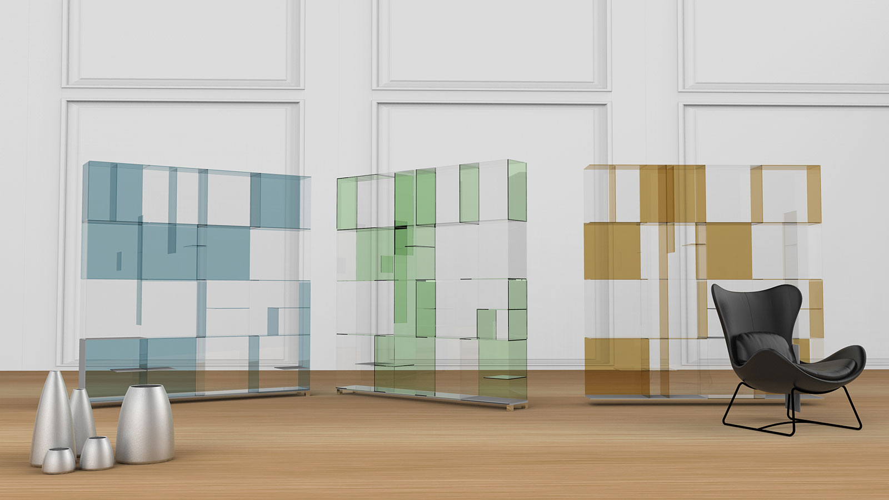

# A 21st Century University in India
SCHOOL OF DESIGN
B Des Program Four Year

Slide 2

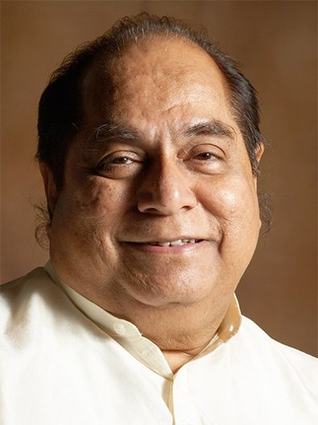
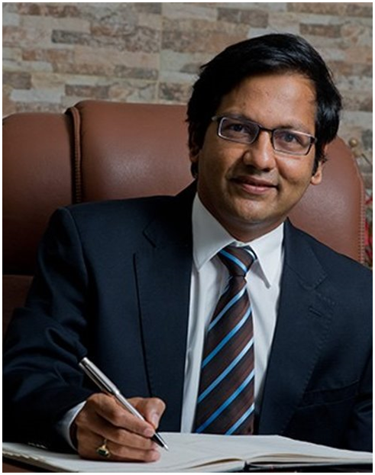
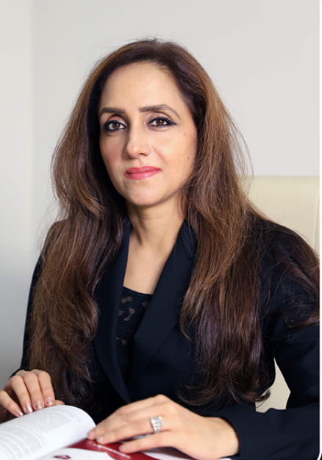
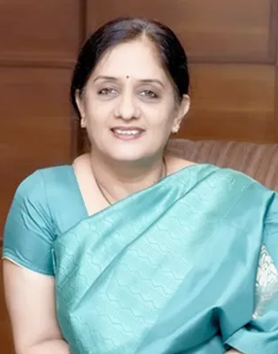
Leadership
Dr. Vijay D. Patil
President & Chancellor
Mrs. Shivani Patil
Vice President
Dr. Sayalee Gankar
Vice-Chancellor
Hon’ble Dr. D. Y. Patil
Padma Shri
www.dypatiluniversitypune.edu.in 02

Slide 3













Legacy to be D Y Patil University
2006
2008
2009
2010
2011
2014
2019
2020
2023
School
of Agriculture
School of
Management
College of
Engineering
School
of
Engineering Academy
School of
Pharmacy
School of
Design
School of
Law
Institute
of
Engineering & Technology
School
of
Architecture
School of Polytechnic
School of Hospitality Studies
www.dypatiluniversitypune.edu.in 03

Slide 4
Vision
“To be a premier school in the field of design education programmes focused to develop knowledge, use of technology with creativity and innovation to apply as a professional”
www.dypatiluniversitypune.edu.in 04

Slide 5

Mission
Prepares students for various careers design field
Understand and develop designs with interdisciplinary knowledge in liberal arts, traditions and values
Provide an inspiring, creative, collaborative, and student-centric learning environment for developing knowledge, skills and abilities for the profession, the environment, and the world at large.
www.dypatiluniversitypune.edu.in 05

Slide 6
Bachelor of Design
B. Des.
Intake 60
Product Design Communication Interior Space &
& Media Design Furniture Design
(Intake 20) (Intake 20) (Intake 20)
www.dypatiluniversitypune.edu.in 06

Slide 7

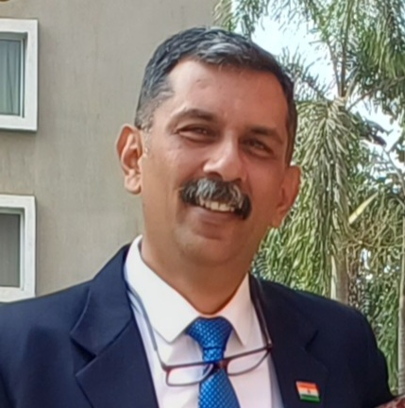
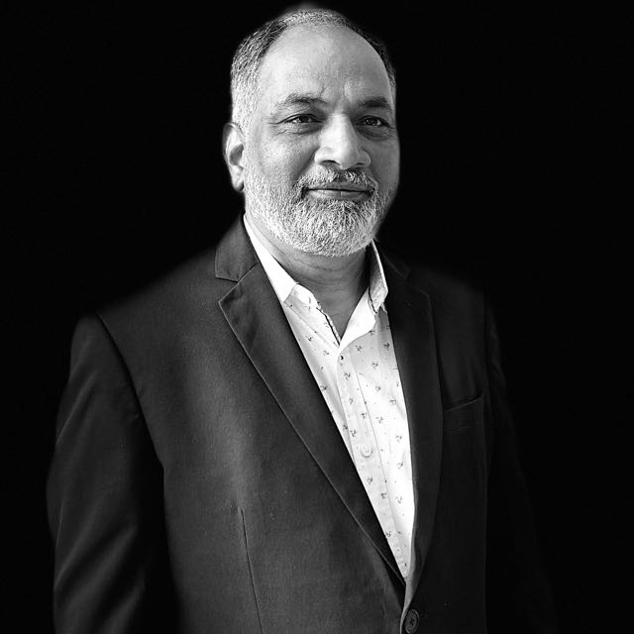
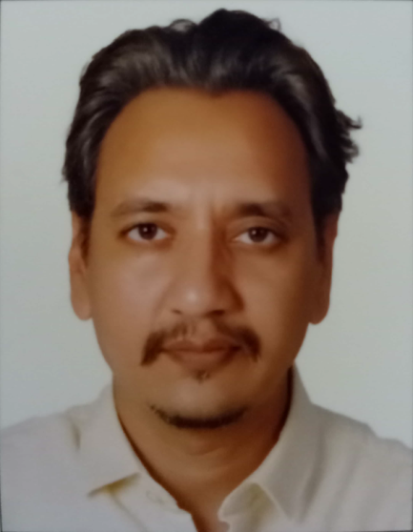
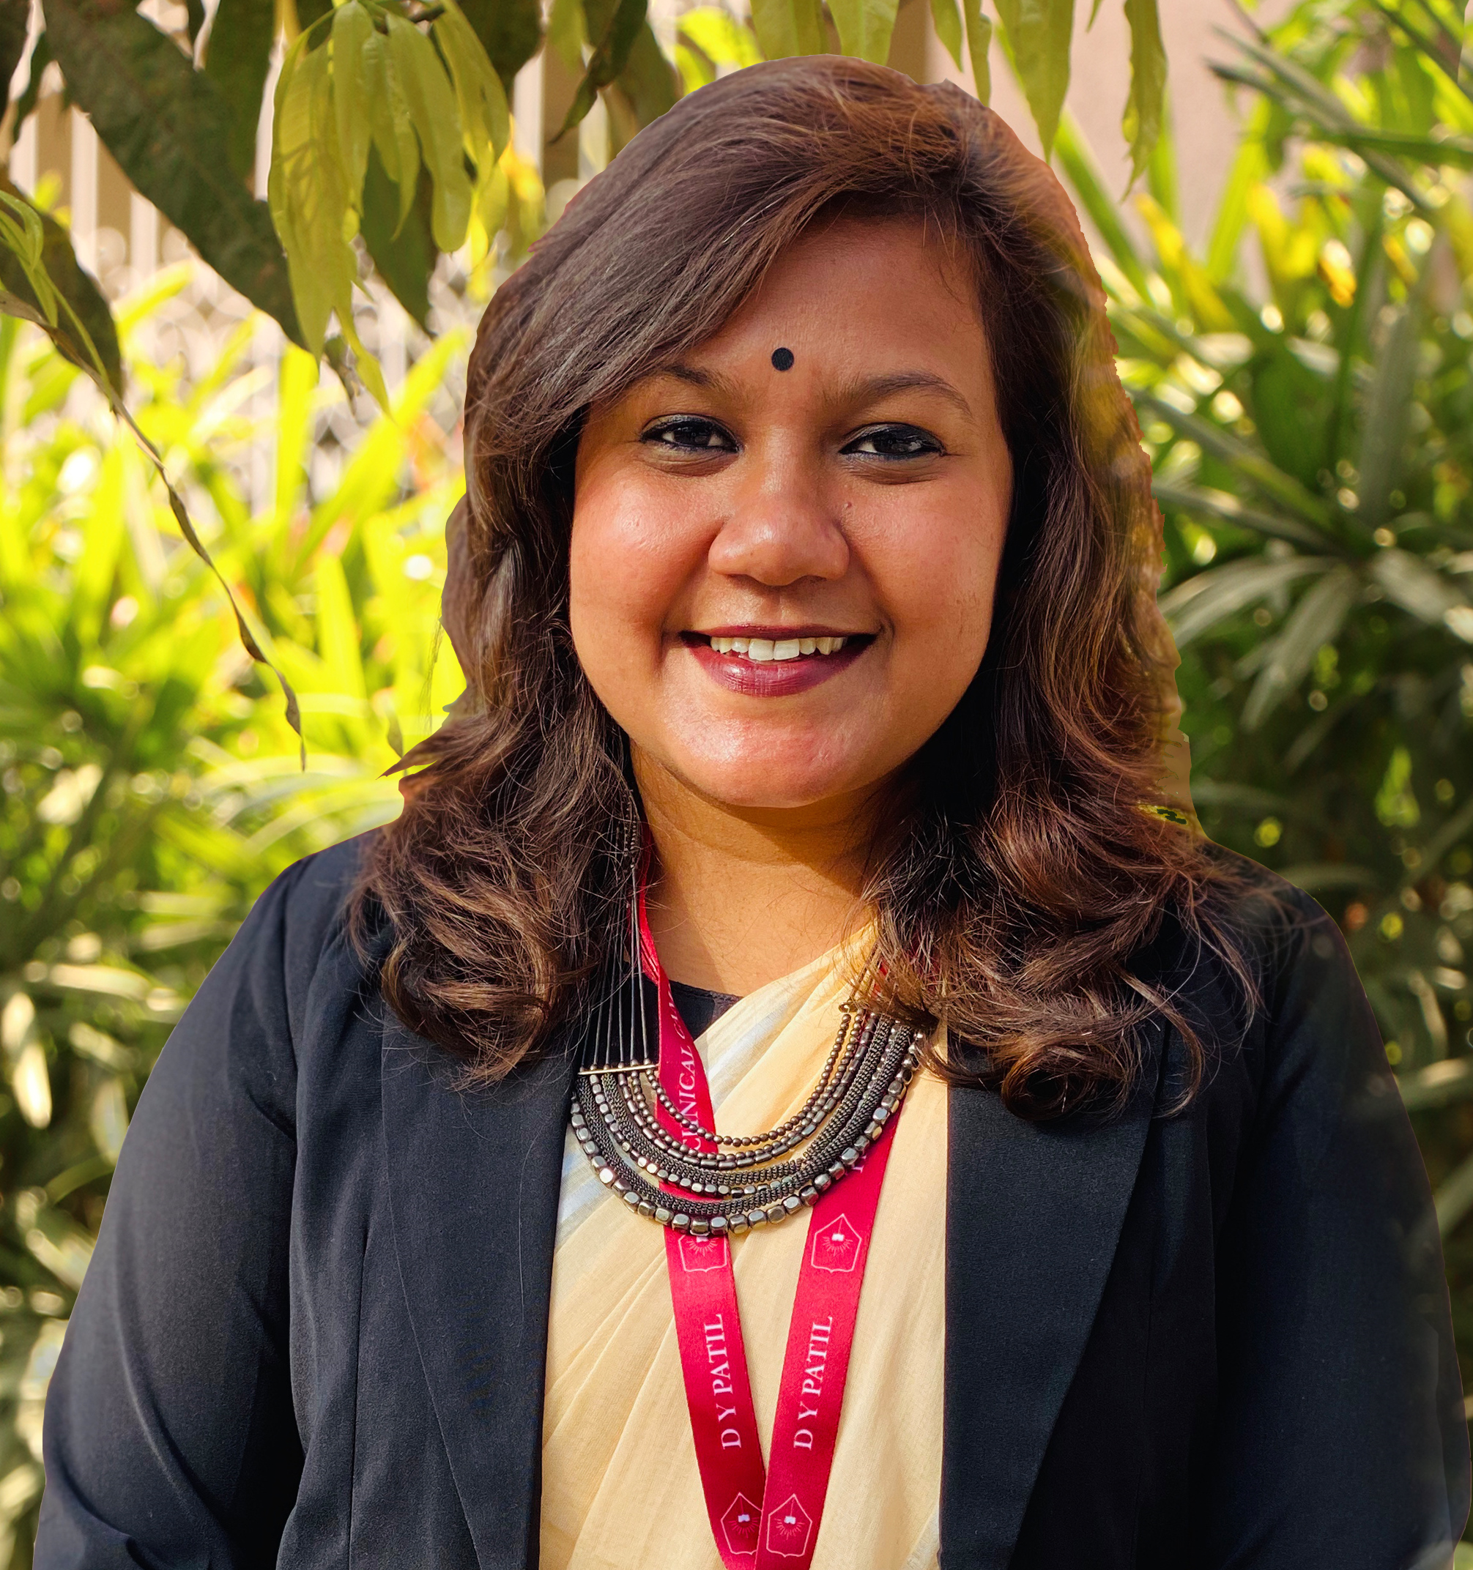
The Academic Leaders
Ar. Swaminath Swamy
HOD
Ar. Rahul Telgote
Program Head
Ar. Sayli Pawar
Assistant Professor
Prof. Omkar Samudra
Principal
School of Design
www.dypatiluniversitypune.edu.in 07

Slide 8


Program Objectives
01
To develop the knowledge, skills, creativity and innovation for design profession.
Ensure the collaborative learning through the interaction with qualified and experienced academicians, industry practioners and professionals.
02
Competency Development programmes and Youth Leadership Programme are deigned to develop the personality, attitude and values.
03
www.dypatiluniversitypune.edu.in 08

Slide 9

Program Objectives
04
Provide opportunity for Certification* programmes in technical, management skills, upcoming areas.
Experiential learning by providing winter and summer internship, live projects opportunities to work in visual agencies and design companies.
05
06
Inculcate innovation, leadership, & entrepreneurial thinking.
Academic delivery with the use of technology, workshops, seminars, visits, study tours, joint studios and webinars.
07
www.dypatiluniversitypune.edu.in 09

Slide 10

BEING PROFESSIONAL
(Fourth Year)
MULTIFACETED PROFESSIONAL
FOUR YEARS AT CAMPUS
FOUNDATION YEAR
(First Year)
CONCEPTUAL YEAR
(Second Year)
TANGIBLE YEAR
(Third Year)
www.dypatiluniversitypune.edu.in 10

Slide 11
Program Structure
Choice Based Credit System
PROFESSIONAL COURSE | TECHNICAL COURSE | ELECTIVES/SPECIALIZATION TRACKS
Art and Design Fundamentals | Applied Science for Designers | Basic Forms in Pottery
Design and Human Evolution | 3D modeling and prototyping | Sculptural Ceramics
Graphics & Drawing | Applied Ergonomics | Communication Theories, Visual Perception and Semiotics
Visual-Arts Studio | Design, Technology and Innovation | Design, Storytelling and Narratives
Typography fundamentals and Exploratory Printing | Animation Design | Ceramic Glazes and Colour Development
Design, Society, Culture and Environment | Film-Video Design | Understanding Human Anatomy
Dissertation | Transportation Design | Global Design Thoughts and Discourse
Thesis Project Work | Materials and Processes
 | Design Management, Planning
 | Professional Practice
 | System Design Project
# Curriculum is designed with practicing professionals
* University has right to make the changes in programme structure / subject basket/ assessment / evaluation.
www.dypatiluniversitypune.edu.in 11

Slide 12
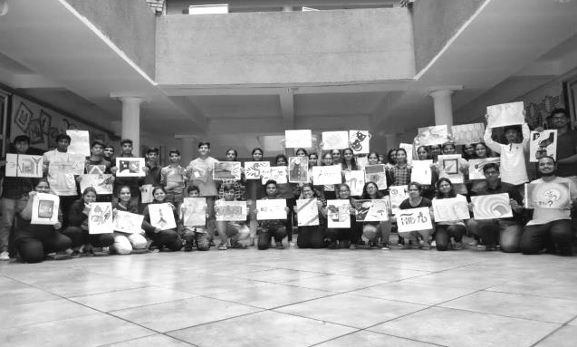
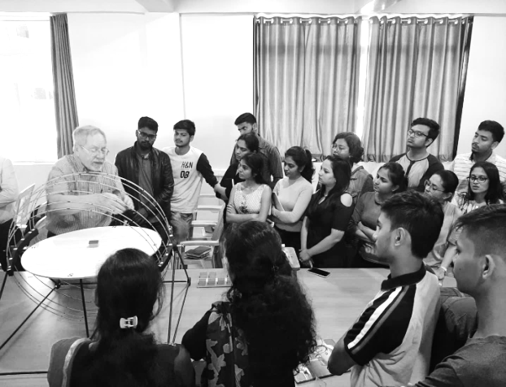
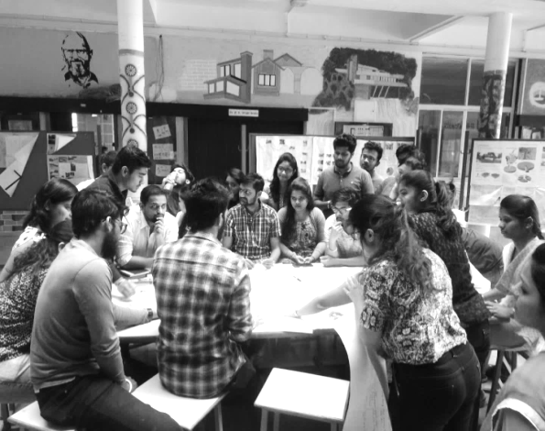
Competency Development Program
CONCEPTUAL SKILLS
INTERPERSONAL SKILLS
TECHNICAL SKILLS
Relation between theory and practice
Aesthetics & Proportions
Visualization
Creativity and Innovation
Sense of Design
Critical thinking and problem solving
Communication Skills
Being Human
Leadership Development Programme
Universal Values like equity, environmental care, accessibility, respect for heritage and ethical practices
SDG Goals and responsibility
History of Design
Design and Mechanical Sciences
Carpentry, Sculpture, Chiselling & metallurgy etc.
Mathematics & Geometry
Drawing
www.dypatiluniversitypune.edu.in 12

Slide 13

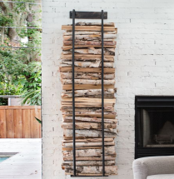






Learning Process
Vertical Studios,
Annual Exhibitions
Orientation Programme
PROGRESSIVE ASSESSMENT
Workshops
Studio Interactions
Final Examination
Semester
PROGRESSIVE ASSESSMENT
Studio Lectures
Certification Programmes
Knowing the Basics
Learning process includes Classroom Sessions, Interactive Presentation, Parallel Studies, Studio Based Assignments, Exhibition, Training in National and International Reputed organizations*
Field Visits,
Parallel Studies,
Professional Trainings
www.dypatiluniversitypune.edu.in 13

Slide 14



Internships and Projects
INTERNSHIP
Professional Training
Winter Projects
Summer Projects
Related Study Project
Focus
Design, Practical Skills
Practical Training
Focus
Assimilate Ignored Skills
www.dypatiluniversitypune.edu.in 16

Slide 15



Professional Skill Development
DESIGN SKILLS AND KNOWLEDGE
ANALYTICAL THINKING SKILLS
ARTISTIC SKILLS
LEGAL KNOWLEDGE
TEAMWORKING SKILLS
EXCELLENT VERBAL COMMUNICATION SKILLS
PROFESSIONAL COMPETENCE
www.dypatiluniversitypune.edu.in 15

Slide 16
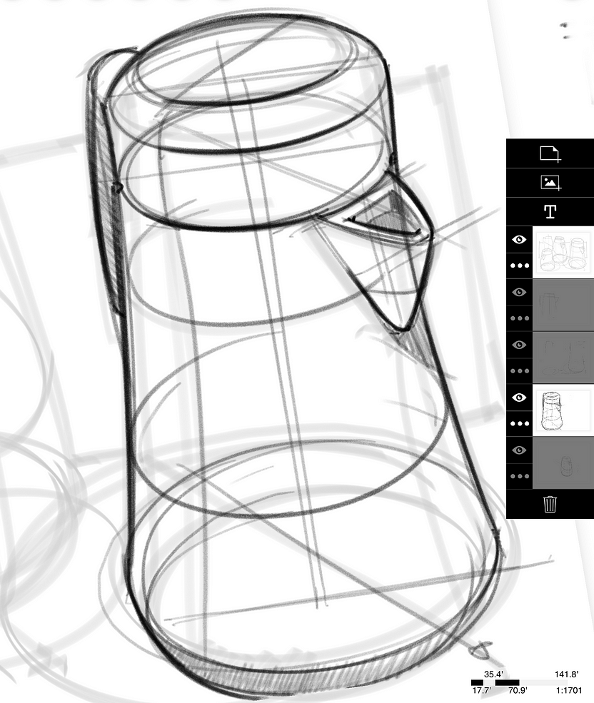
Corporate Relations & Career Services
Industry Partnership l Collaborations l MOU l Training
Proximity to Indian Corporates in Mumbai and Pune
University campus has become the “Seat of Education and Knowledge”. It is preferential education destination for students. Campus is equally distanced from Pune and Mumbai. Due to which academicians, industry practioners and industry from India’s Financial Capital Mumbai are partnered and providing training, internship and placement.
Industry Focused Learning:
Programs are designed, developed and reviewed in consultation with academic experts and leading industry practitioners for ensuring relevant learning.
Practice, Experience and Experimentation
Industry projects, Joint programs, certifications, research, internships and placements are the outcome of partnership.
Mumbai | Pimpri Chinchwad Industry(PCMC) | PUNE
IT Industry- Hinjewadi | MIDC-Chakan | MIDC-Talegaon
www.dypatiluniversitypune.edu.in 17
www.dypatiluniversitypune.edu.in 11

Slide 17

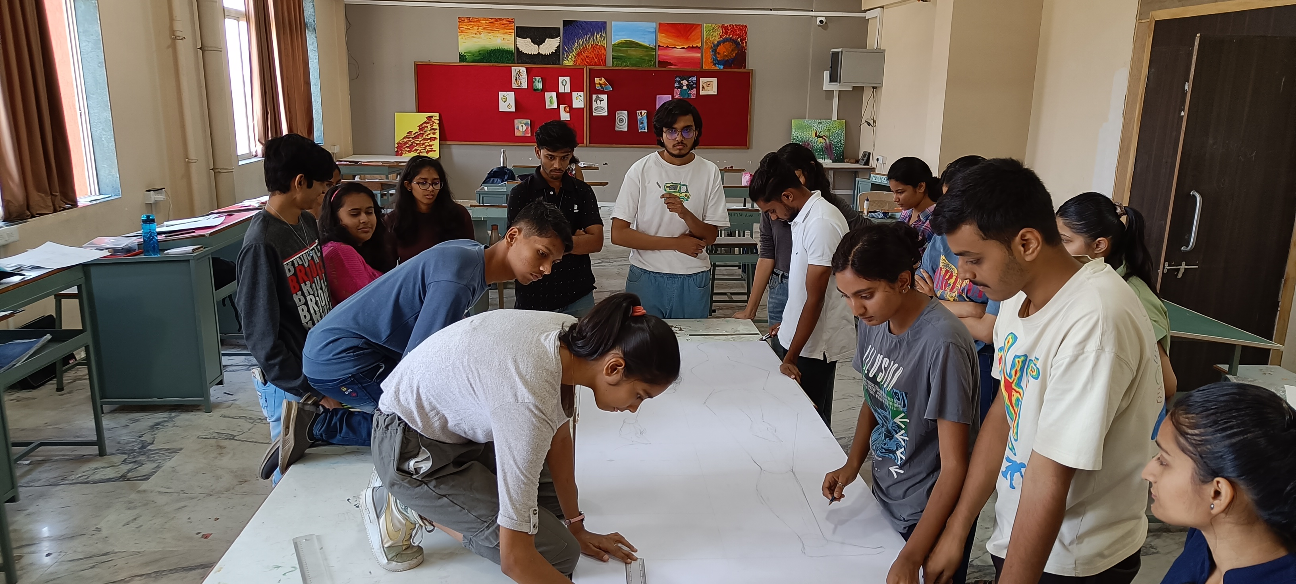

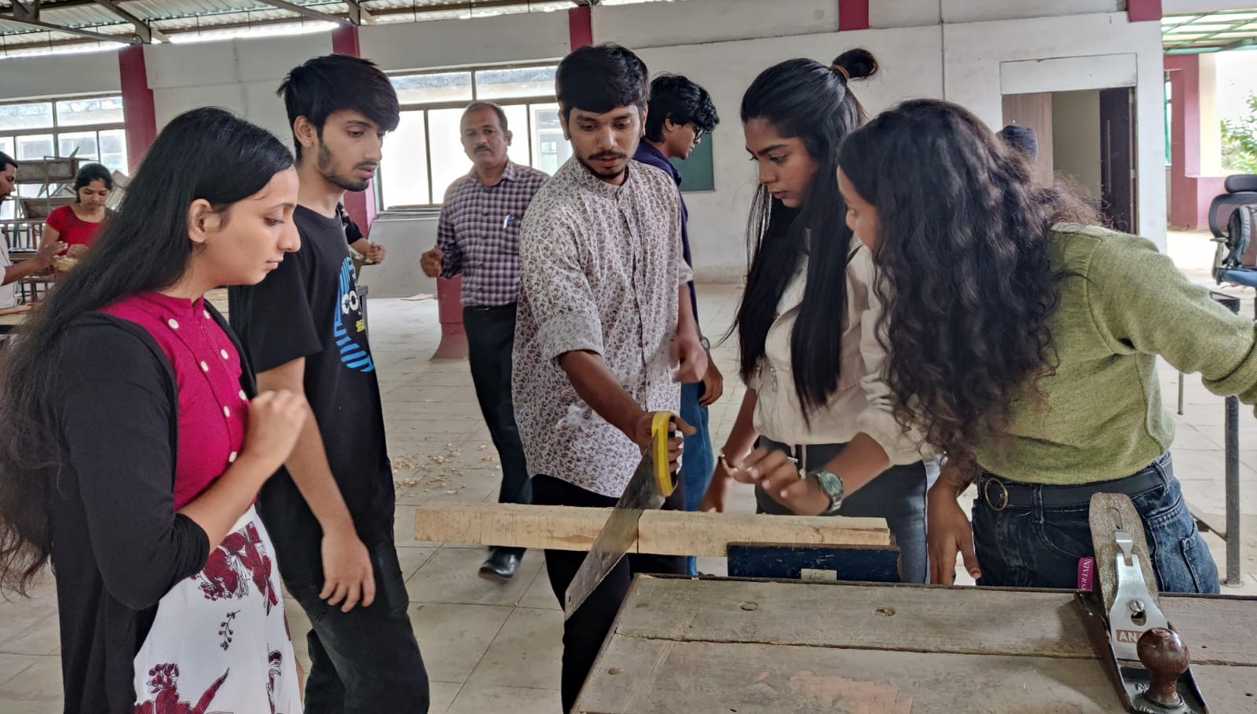
Laboratories
MATERIAL LAB
Material Museum is created for studying latest construction materials, technology and specifications, samples, prototypes, miniature and models. Material Lab consists of Samples of Plumbing Equipment, Samples of Carpentry Equipment, Samples of Electrical Equipment, Construction Tools, Joinery Details, Miniature Models of Joinery for different materials etc.
RESEARCH & CONSULTANCY CELL
MATERIAL
The Research & Consultancy Cell undertakes architectural, urban design and environmental Impact assessment projects & research works and provides Opportunities to the students to work with, acquire more knowledge & learn practical aspects of the practice.
VIRTUAL REALITY LAB
Students are provided with an access to and training in the latest technology and Virtual Reality gadgets.
SOFTWARE
SURVEY
3D PRINTING LAB
3D Printers are made available to the students for giving them an exposure to the latest technology in the market. This helps them visualize and produce their design more efficiently and realistically.
COMPUTER LAB
The LAB is equipped with latest configuration machines with all the latest software required for architectural education and architectural practice. Ex. Auto Desk AutoCAD, Autodesk Revit, Coral Graphic Suite, Sketch-up Pro, V-Ray for Sketch Up, V-Ray for Photoshop, Adobe Photoshop Suite, Integrated Environmental Solutions etc.
CARPENTRY LAB
Exposure to hands on activity is promoted and students participations is made mandatory at DYPUSoD. A well equipped Carpentry Lab with latest tools and equipments is established at the University Campus.
www.dypatiluniversitypune.edu.in 18

Slide 18
Investment in Labs
Total Investments
Rs. 5 Crore.
02
03
01
04
01
RESEARCH LAB
02
MATERIAL LAB
03
SURVEY LAB
04
COMPUTER LAB
Latest IT infrastructure and Interaction Spaces for Students, Faculties and Clients.
Construction materials, samples, prototypes and miniature models etc.
Well equipped Survey & leveling and Climatology labs with latest Gazettes and equipment's
Latest Configuration Computers, Laptops with Latest Software.
www.dypatiluniversitypune.edu.in 19

Slide 19
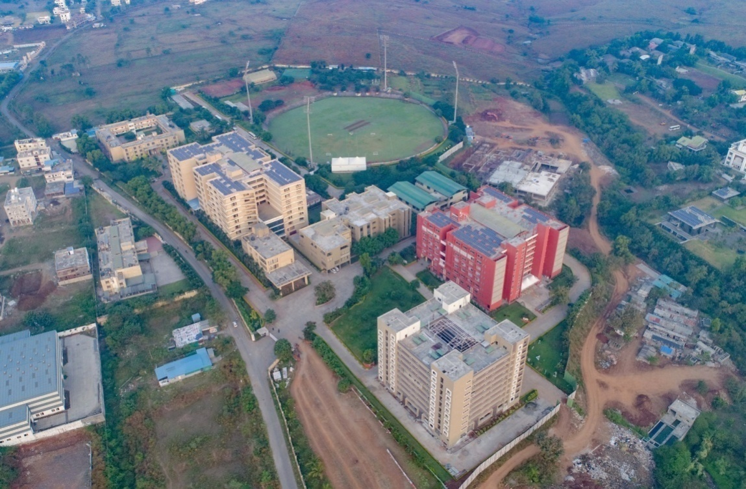

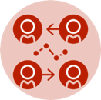



Campus Life
Book Club
Cultural Events
Industry Interaction
Sports Club
Literature Forum
Community Engagement
Photography Club
Film and Music Club
www.dypatiluniversitypune.edu.in 20

Slide 20
Campus Life
50%
50%
Faculty
Professional Practioners
www.dypatiluniversitypune.edu.in 21

Slide 21
# A 21st Century University in India
Thank You
For Admission Contact
Mobile No – 8448444230 /9765691310
Technical Helpline No - 8104502268
Phone No –020-71533830 www.dypatiluniversitypune.edu.in
E- Mail: admissions@dypatiluniversitypune.edu.in
info@dypatiluniversitypune.edu.in
www.dypatiluniversitypune.edu.in 22

